Slide 1
Digital Portfolio
STUDENT NAME: Nishal R
REGISTER NO AND NMID:2428C0494 , 83616972AAB9465B2494D841E6CC03A0
DEPARTMENT: B.Sc AIML
COLLEGE: KPR College of Arts Science and Research Bharathiar University

Slide 2
PROJECT TITLE
Business Analyst Portfolio

Slide 3


AGENDA
Problem Statement
Project Overview
End Users
Tools and Technologies
Portfolio design and Layout
Features and Functionality
Results and Screenshots
Conclusion
Github Link
3/21/2024 Annual Review

Slide 4

PROBLEM STATEMENT
Many student portfolios lack modern design and interactive elements.
Traditional resumes do not effectively showcase skills, projects, and achievements.
A need for a stylish, 3D interactive portfolio that highlights both academic background and Business Analyst projects.

Slide 5

PROJECT OVERVIEW
Designed and developed a personal portfolio website with 3D effects, glassmorphism, and parallax animations.
Portfolio includes: • Personal Information (Name, Department, College, Email) • Projects (Business Analyst Portfolio, Sales Dashboard, Churn Analysis) • Achievements (Dashboards, Data Cleaning, EDA) • Skills (Excel, SQL, Python, Power BI, Tableau)

Slide 6

WHO ARE THE END USERS?
Recruiters and Hiring Managers
Academic Faculty & Evaluators
Peers and Collaborators
Companies looking for Business Analysts / Data Analysts

Slide 7

TOOLS AND TECHNIQUES
Frontend: HTML, CSS, JavaScript
Styling: Glassmorphism, Parallax, 3D tilt effects
Fonts & Icons: Google Fonts (Poppins), modern UI elements
Deployment Ready for hosting on GitHub Pages or personal website

Slide 8
PORTFOLIO DESIGN AND LAYOUT
Hero Section: Introduction with Name, Department, and Profile Card
About Section: Who I Am, What I Do, What I Want
Skills Section: Technical skills in BA/AI-ML tools
Projects Section: Featured “Business Analyst Portfolio”
Achievements Section: Timeline of milestones
Contact Section: Email and form
3D/Interactive Effects: Tilt-on-hover, parallax background, floating chips
8

Slide 9
FEATURES AND FUNCTIONALITY
3D Hover Effects using JavaScript
Glassmorphism Cards with shadows
Interactive Navigation with smooth scrolling
Dynamic Reveal Animations on scroll
Responsive Layout (mobile + desktop)
Contact form with demo interaction

Slide 10
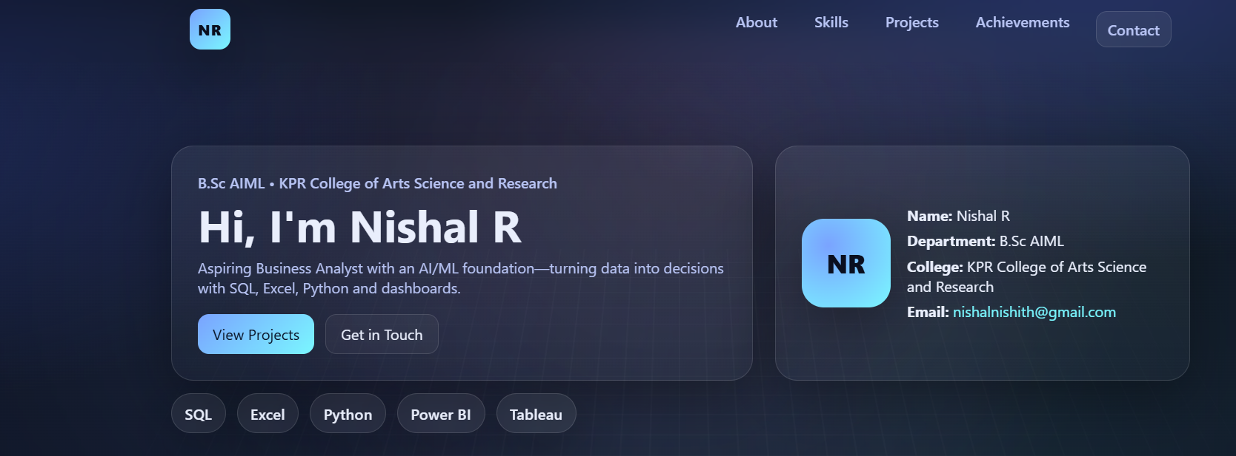

RESULTS AND SCREENSHOTS
Modern, professional-looking online portfolio
Improved visual appeal and interactivity
Effectively highlights projects, achievements, and skills
Ready to present to recruiters and faculty (Insert screenshots of Hero, Skills, Projects, Achievements sections here)
3/21/2024 Annual Review
10

Slide 11
CONCLUSION
Modern, professional-looking online portfolio
Improved visual appeal and interactivity
Effectively highlights projects, achievements, and skills
Ready to present to recruiters and faculty (Insert screenshots of Hero, Skills, Projects, Achievements sections here)
11

Slide 12
GITHUB LINK
Portfolio Link:https://github.com/Nishal-15/Naan-Mudhalvan

